Slide 1

Event Handlers
bubbling
Aris Markogiannakis
City University - Short Courses
CS3606 : JavaScript 2: Advanced Javascript for Websites and Web

Slide 2
This week
We will learn about:
DOM Events
Custom Events

Slide 3
JavaScript an event-driven Language
JavaScript an event driven language
You can interact with the browser with some of the following events
We can write code that is executed when those events are fired
Click
Mousedown
KeyUp
MouseUp

Slide 4
Event Handlers
Event Handlers
Specific Event
Attached to a specific element in the DOM
Many handlers can be attached to a specific event/element
Use addEventListener() to attach handlers
el.addEventListener(event_type, func_to_run);
Or, use an anonymous function to handle events
el.addEventListener(eventtype. function() { });

Slide 5
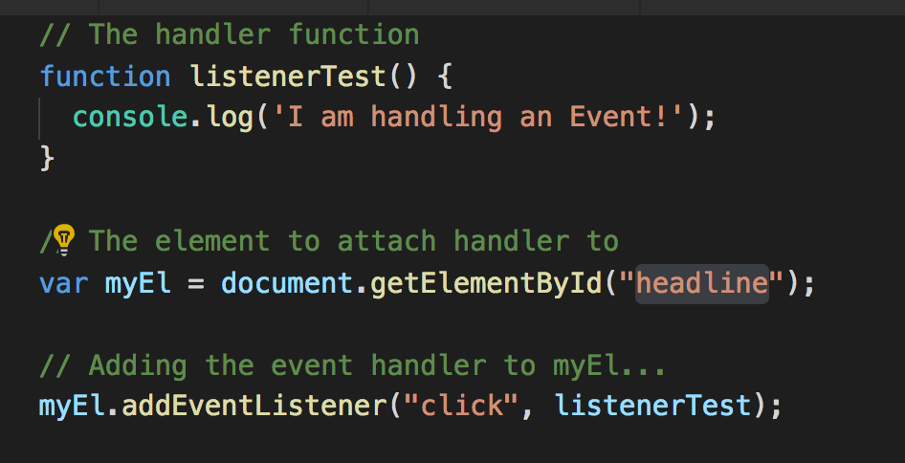
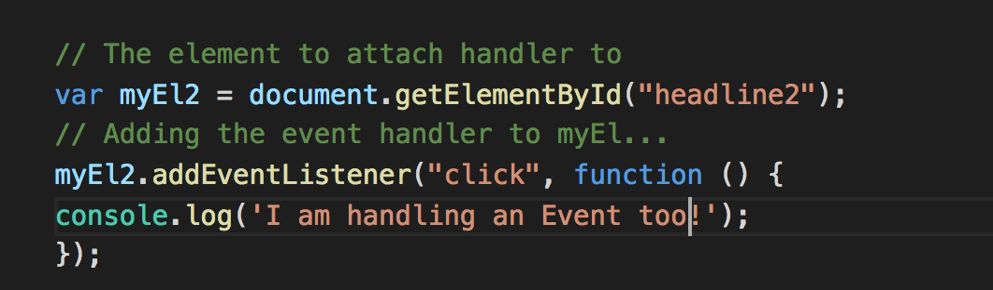
Event Handlers

Slide 6
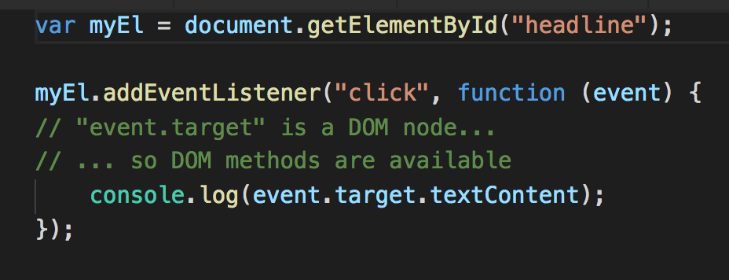
Click event information
Depending on the type of event, the event object:
Contains x and y co-ordinates of the click
Key pressed of the key up event
All events contain target and currentTarget properties

Slide 7
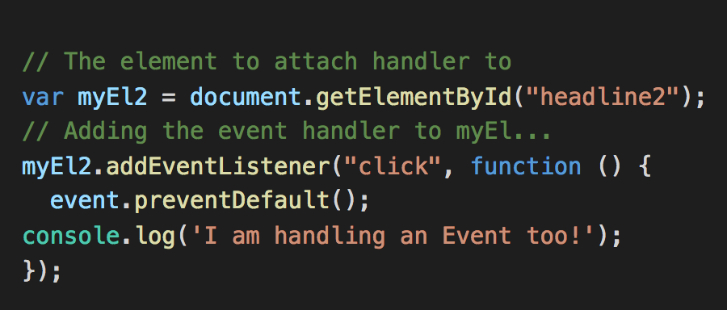
Events default functionality
The browser has built-in functionality for some of the events.
When the click event fires from an anchor <a> the browser opens the page referenced in the href attribute.
This default behavior occurs after any event handlers attached to the element have completed.
If we dont want the default behavior to occure we can stop it inside our listener function.
We can do this with the preventDefault() method.

Slide 8
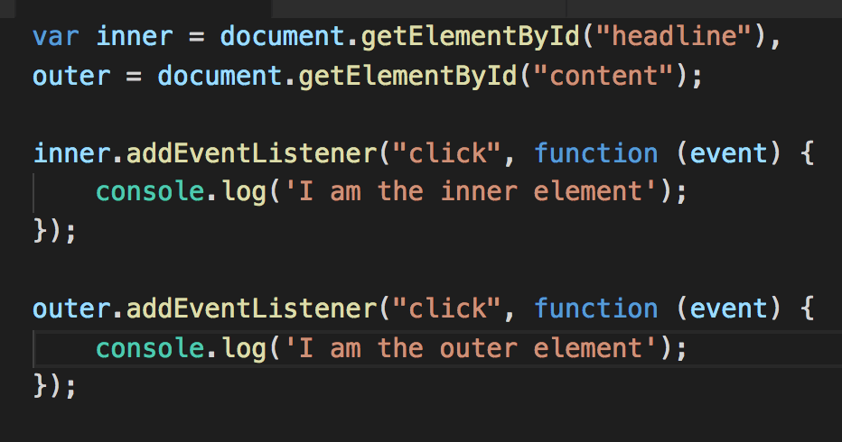
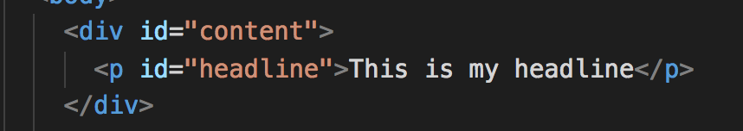
Event bubbling
For some event types, when they are triggered:
They are fired on the element that triggered them: handlers attached to that element run.
Then the event is fired for each ancestor of the trigger element.
If any of the ancestor elements have handlers attached to the same event, they will also run.

Slide 9
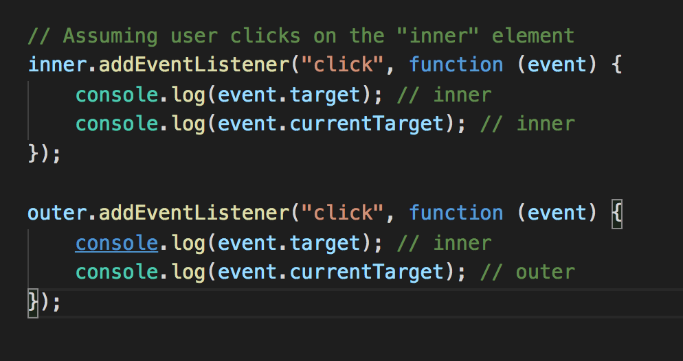
Event Bubbling
If the user clicks on the “headline” element:
First, the event handler attached to the “headline” element will run
Then, the handler attached to the “content” element will run
Both handlers will receive an event object, but the object will be slightly different
For every handler in the chain, the event.target property will always be a reference to the element that initially fired the event.
In the example, this will be the “headline” element
But the object also has a currentTarget property which contains a reference to the element who’s handler is currently being executed event.currentTarget;

Slide 10
Event Bubbling
Do
Exercise 1
The event object has a method we can use to prevent the event from bubbling up through the DOM
event.stopPropagation();
Any function in the propagation chain can call this method, and it will cause the event to stop bubbling at that point in the DOM

Slide 11
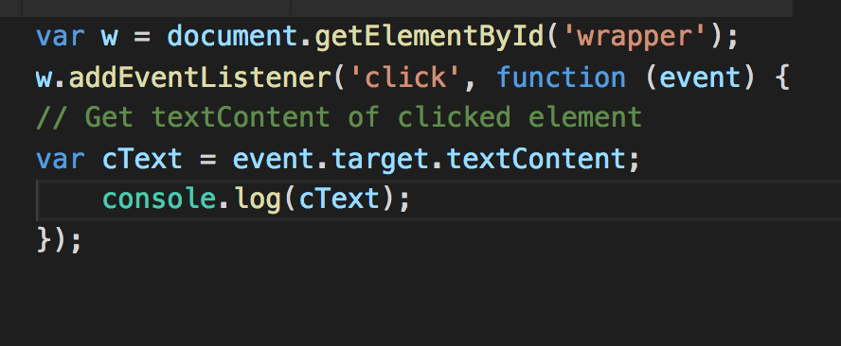
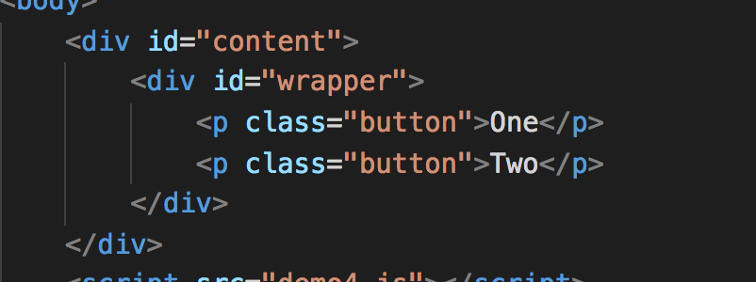
Event Delegation
A pattern which takes advantages of bubbling in order to write more efficient and flexible event handlers.
The event is fired on each ancestor of the element that triggered the event
Each handler in this chain receives the event object as an argument.
The event object has a target property which is a reference to the element that triggered the event.
In other words, at any point in the chain, we can determine which element initially triggered the event

Slide 12
Delegation is useful
Do
Exercise 2
We can write less code and declare fewer event handlers
If we add elements to the DOM dynamically, we do not have to attach new event handlers to them.
Their events will still bubble up the DOM

Slide 13
But there is a problem....
If you click inside the button-wrapper element, but not on an actual button, the event is still fired!
We need to perform some checks within our handler that stop this from happening.
In other words, we need to implement a filter
We can do this by examining the target element and ensuring it is one we are interested in before continuing. Depending on our needs, we could:
Check if the element is a “p” tag (use nodeName)
Check if the element has the class button (use classList.contains)
Check if the element has a data-action attribute (use getAttribute)

Slide 14
Delegation Filtering
Task: Implement one of these tests within your event handler from exercise 2 and then do exercise 3.
When choosing which method to use, consider that other elements, which we do not want our code to respond to clicks on, may get added to the wrapper

